Slide 1

Introduction to IT Project Management and Entrepreneurship
Lecture 4
Deepak Chandra Roy
Adjunct Faculty, CSE, EWU
deepak.kth@gmail.com
01685441156

Slide 2
Agenda
Developing a project schedule using Gantt charts
Overview of Agile
Agile Principles
Agile Practices
Agile Roles
Benefits of Agile

Slide 3
Gantt Chart
A Gantt Chart is a visual representation of a project schedule that shows tasks, durations, dependencies, and milestones
It provides a comprehensive view of project timelines and helps in planning, scheduling, and tracking progress.

Slide 4
Gantt Chart Cont..
Horizontal Axis: Timeline or project duration.
Vertical Axis: List of tasks or activities.
Bars: Representing tasks with start and end dates.
Milestones: Significant points in the project.

Slide 5
Creating Gantt Chart Cont..
Software Tools: Microsoft Excel, Microsoft Project, GanttProject, Project Libre etc.
Task List: Identify and list all tasks involved in the project.
Duration: Estimate the time each task will take.
Dependencies: Identify task relationships and dependencies.
Milestones: Mark key project milestones.

Slide 6
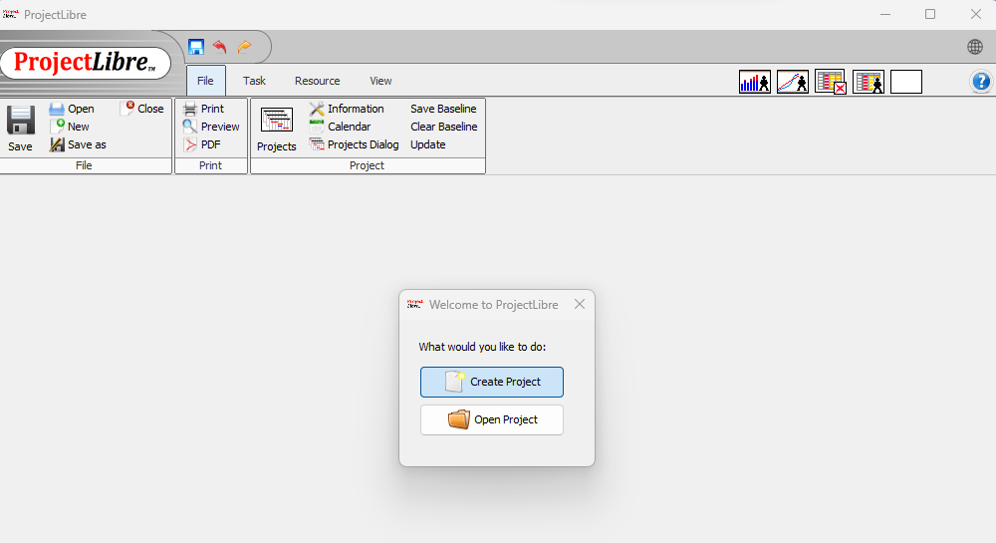
Gantt Chart Example

Slide 7
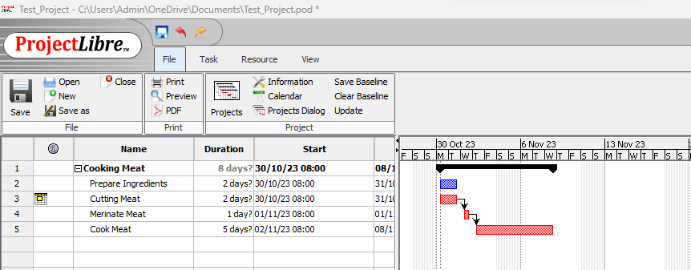
Gantt Chart Example

Slide 8
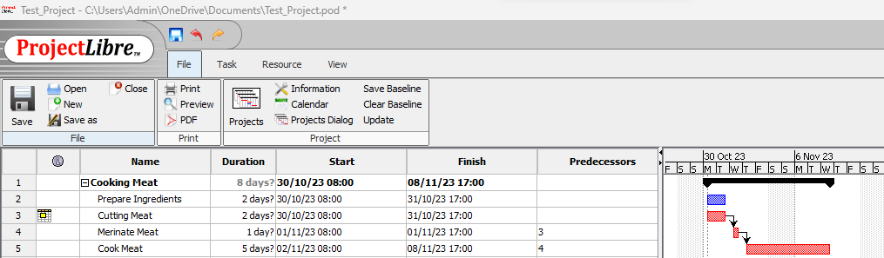
Gantt Chart Example

Slide 9
Advantages of Gantt Chart
Visual Clarity: Easily understand project timelines.
Task Relationships: Clearly see dependencies.
Resource Allocation: Efficiently assign resources.
Progress Tracking: Monitor project advancement.

Slide 10
Limitations of Gantt Chart
Complexity: Can become complex for large projects.
Dynamic Changes: Limited flexibility for dynamic changes.
Resource Details: May not provide detailed resource information.

Slide 11
Agile Methodology
What is Agile?
Agile is a project management and product development approach that prioritizes flexibility, collaboration, and customer satisfaction.
Key Characteristics: Iterative, Incremental, Adaptive, Collaborative
Notes:
1. Agile:
Definition: Agile is a project management and product development approach that emphasizes flexibility, collaboration, and customer satisfaction. It is a broader philosophy or mindset guiding how teams work, rather than a specific process or set of practices.
Key Characteristics: Customer collaboration, responding to change, iterative development, and delivering value in short cycles.
Example Methodologies: Scrum, Kanban, Extreme Programming (XP).
2. Iterative:
Definition: Iterative development involves repeating cycles or iterations of a development process. Each iteration produces a partial but functional version of the overall product. The goal is to refine and enhance the product with each iteration.
Key Characteristics: Repeating cycles, continuous refinement, feedback loops.
Example: In iterative development, a team might complete a subset of features in the first iteration, receive feedback, and then use that feedback to refine and add more features in subsequent iterations.
3. Incremental:
Definition: Incremental development involves breaking down a project into smaller, manageable parts called increments. Each increment represents a portion of the complete product and is developed independently. The increments are integrated to form the final product.
Key Characteristics: Independent development of components, integration of increments.
Example: In incremental development, a team might develop and deliver specific features or modules in separate increments. These increments are then integrated into the existing product, gradually building the complete solution.
Differences:
Scope:
Agile: Focuses on a mindset or philosophy, guiding principles for adaptive and customer-centric development.
Iterative: Involves repeating cycles with the goal of refining and improving the overall product.
Incremental: Focuses on breaking down the project into manageable parts that are developed and integrated independently.
Approach:
Agile: Emphasizes a customer-centric, collaborative, and flexible approach.
Iterative: Involves repeating cycles with feedback loops to refine the product.
Incremental: Involves developing and integrating independent parts of the project.
Output:
Agile: A mindset or philosophy guiding how work is done.
Iterative: Multiple versions or iterations of the product, each building on the previous one.
Incremental: Independent parts or increments of the product that are integrated to form the final solution.
Timing:
Agile: Continuous and adaptive development, responding to changing requirements.
Iterative: Development occurs in fixed, repeating cycles.
Incremental: Development and integration occur incrementally, adding new features or modules.
In practice, Agile methodologies often incorporate both iterative and incremental elements. Iterative and incremental approaches complement each other, contributing to the Agile philosophy of delivering value in short cycles with the ability to adapt to change.

Slide 12
Agile Manifesto
The Agile Manifesto was created by a group of software developers in 2001.
The Agile Manifesto consists of four key values and twelve principles.
Four Key Values:
Individuals and interactions over processes and tools
Working software over comprehensive documentation
Customer collaboration over contract negotiation
Responding to change over following a plan

Slide 13
Agile Manifesto (Cont..)
Value 1: Individuals and interactions
In the past, a lot of software teams would concentrate on having the best possible tools or processes with which to build their software. The Agile Manifesto suggests that while those things are important, the people behind the processes are even more so.
Having the right group of individuals on your software team is vital to success. The best possible tools in the wrong hands are worthless. Perhaps even more important is how these individuals communicate with each other. The interactions between team members are what helps them to collaborate and solve any problems that arise.
Source: https://www.productboard.com/glossary/agile-values/

Slide 14
Agile Manifesto (Cont..)
Value 2: Working software
Previously, software developers would spend ages creating detailed documentation. That was before they even started writing a single line of code. And while documentation isn’t a bad thing, there comes a point when you should focus on providing your customers with working software.
The Agile Manifesto places shipping software to your customers as one of the highest priorities. You can then gather feedback to help you improve future releases.

Slide 15
Agile Manifesto (Cont..)
Value 3: Customer collaboration
Once upon a time, contracts were king. You would draw up contracts with your customers who would then detail the finished product. As a result, there was often a contrast between what the contract said, what the product did, and what the customer actually required.
According to the Agile Manifesto, the focus should be on continuous development. You need to build a feedback loop with your customers so that you can constantly ensure that your product works for them.

Slide 16
Agile Manifesto (Cont..)
Value 4: Responding to change
Can you imagine a time where you would draw up a roadmap and it would never change? Well, in the past that’s exactly what happened.
The trouble with static roadmaps is that we don’t live in a static world. Needs and requirements are always shifting, and priorities are always changing. That static roadmap will soon grow outdated.
That’s why the Agile Manifesto suggests that a software team should have the ability to pivot and change direction whenever they need to, with a flexible roadmap that reflects that. A dynamic roadmap can change from quarter to quarter, sometimes even month to month, and agile teams are able to keep up with those changes.

Slide 17
12 Agile Principles
The 12 Agile Principles, as outlined in the Agile Manifesto, are:
Customer satisfaction through early and continuous delivery of valuable software
Deliver working software frequently, with a preference for shorter timescales.
Welcome changing requirements, even late in development
Agile processes harness change for the customer's competitive advantage.
Deliver working software frequently, with a preference to the shorter timescale
Agile aims to deliver a working product incrementally and iteratively to provide value quickly.
Collaboration between business people and developers throughout the project
Continuous collaboration between stakeholders, including customers, and the development team is essential.
Build projects around motivated individuals, and give them the environment and support they need
Trust and support the team members, allowing them to do their work effectively.
Use face-to-face communication whenever possible
Face-to-face communication is considered the most efficient and effective way to convey information within a development team.

Slide 18
12 Agile Principles
7) Working software is the primary measure of progress
The ultimate goal is to deliver a functional product, and progress is measured by the amount of working software delivered.
8) Maintain a sustainable pace of work for the developers
Avoid overloading the development team to ensure a sustainable and consistent pace of work over the long term.
9) Continuous attention to technical excellence and good design enhances agility
Emphasize the importance of quality, good design, and technical excellence to maintain agility.
10) Simplicity—the art of maximizing the amount of work not done—is essential
Focus on what is necessary to meet the requirements and avoid unnecessary work.
11) Self-organizing teams encourage great architectures, requirements, and designs
Trust the team to make decisions and encourage self-organization for better results.
At regular intervals, the team reflects on how to become more effective, then tunes and adjusts its behavior accordingly
Regularly assess and adapt processes to improve efficiency and effectiveness.
These principles guide the Agile mindset and provide a foundation for Agile methodologies such as Scrum, Kanban, and Extreme Programming (XP). They emphasize customer collaboration, flexibility, and a focus on delivering value.
Example: "Welcome changing requirements, even late in development. Agile processes harness change for the customer's competitive advantage."

Slide 19
Agile Practices
Scrum:Time-boxed iterations (Sprints)
Roles: Scrum Master, Product Owner, Development Team
Daily Stand-ups, Sprint Planning, Sprint Review, Sprint Retrospective

Slide 20
(cont.)
Kanban:
Visualizing work on a board
Limiting work in progress
Continuous delivery
Extreme Programming (XP):
Pair programming
Test-driven development
Continuous integration

Slide 21
Agile Roles
Scrum Roles:Scrum Master: Facilitator and servant-leader
Product Owner: Represents the customer, prioritizes backlog
Development Team: Cross-functional, self-organizing

Slide 22
Benefits of Agile
Flexibility and Adaptability:
Explanation: Agile methodologies are designed to accommodate changes in requirements, priorities, and project scope. This flexibility allows teams to respond quickly to evolving customer needs or market conditions.
Impact: Teams can adjust project priorities, features, and deliverables at the end of each iteration, ensuring that the final product better aligns with current business goals.
Customer Satisfaction:
Explanation: Regular customer involvement and feedback throughout the development process enable the team to better understand and meet customer expectations. This iterative approach ensures that the final product aligns closely with customer needs.
Impact: Higher customer satisfaction as the end product is more likely to meet or exceed customer expectations, leading to increased customer trust and loyalty.
Faster Time-to-Market:
Explanation: Agile emphasizes delivering a minimum viable product (MVP) quickly and then incrementally adding features. This results in faster release cycles and allows organizations to respond rapidly to market demands.
Impact: Reduced time between concept and delivery, enabling businesses to seize market opportunities and gain a competitive edge.
Improved Quality:
Explanation: Agile practices, such as continuous integration, automated testing, and frequent reviews, contribute to higher software quality. Issues are identified and addressed early in the development process.
Impact: Fewer defects, lower debugging costs, and increased overall product quality contribute to a more reliable and stable end product.

Slide 23
Benefits of Agile (Cont..)
Enhanced Team Collaboration:
Explanation: Agile promotes frequent communication, collaboration, and a shared understanding of goals among team members and stakeholders. Cross-functional teams work closely together throughout the project.
Impact: Improved team morale, creativity, and productivity, leading to a more collaborative and cohesive working environment.
Visibility and Transparency:
Explanation: Agile methodologies provide clear visibility into project progress through artifacts like burn-down charts, task boards, and regular status meetings. This transparency helps identify potential issues early on.
Impact: Stakeholders have a clear understanding of project status, potential risks, and upcoming deliverables, allowing for informed decision-making.
Cost Control:
Explanation: Agile's iterative approach allows for continuous reassessment of project priorities and scope. This adaptability helps control costs by avoiding unnecessary work and enabling more effective resource allocation.
Impact: Improved budget management, as resources are directed toward high-priority features and adjustments can be made based on evolving project requirements.
Risk Management:
Explanation: Agile's incremental and iterative nature facilitates early identification and mitigation of project risks. Regular reviews and adaptations help teams address issues before they escalate.
Impact: Proactive risk management results in a more predictable and controllable project, reducing the likelihood of major setbacks.

Slide 24
Benefits of Agile (Cont..)
Increased Employee Satisfaction:
Explanation: Agile principles, such as self-organization and a focus on continuous improvement, contribute to a positive work environment. Team members are empowered, and their input is valued.
Impact: Higher job satisfaction, reduced turnover, and increased team motivation, leading to a more engaged and productive workforce.
Continuous Improvement:
Explanation: Agile emphasizes retrospectives and feedback loops, encouraging teams to reflect on their performance and identify areas for improvement. Continuous improvement becomes a natural part of the development process.
Impact: Ongoing learning and adaptation result in increasingly efficient and effective development processes over time.
These benefits collectively contribute to the overall success of Agile projects, making it a preferred methodology for many organizations aiming to deliver value in a dynamic and rapidly changing business environment.

Slide 25
Challenges of Agile
Organizational Resistance: Change can be met with resistance.
Documentation Concerns: Some traditional documentation may be reduced.
Adaptability: Agile requires a cultural shift and ongoing adaptation.

